Slide 1
Proposed PMNCH 2022 Advocacy Priorities
Feedback from consultations convened by the PMNCH Strategic Advocacy Committee
Ann Starrs
Co-Chair
Strategic Advocacy Committee
7 Dec 2021
Ann
Notes:
Priorities that we are proposing today on behalf of the Strategic Advocacy Committee (SAC) have emerged from a set of recent consultations with PMNCH committees, working groups and constituencies, including the current online survey of members about their advocacy needs and priorities
This includes inputs from the Partner Engagement in Countries Committee (PECC), as well as the Knowledge & Evidence Working Group and the Accountability Working Group
Our focus thus far has been primarily on the “what” – we have not yet leaned in on the “how”, which will be the focus of the 2022 work-planning process at a retreat in the new year. Having said that, some reference to the “how” is an important input into defining what we want to achieve, as the “how” is intertwined with PMNCH’s comparative advantage and uniqueness.
That is why the last two slides I will share will give an initial sense of how we see our top advocacy goals for 2022 in relation to different types of commitments (financing, policy, and/or service delivery), and how each of these goals can be approached through specific advocacy products and processes.

Slide 2

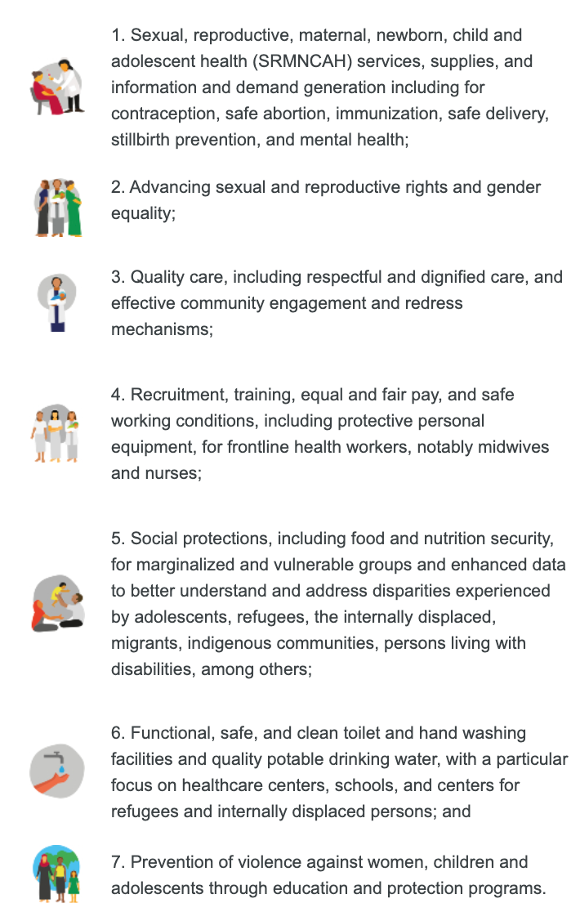
PMNCH Call to Action on COVID-19
The pandemic is disrupting the provision of life-saving services, contributing to the erosion of SRHR of women and adolescents, and further exposing and exacerbating systematic and structural racial, ethnic and gender inequities everywhere. Our call to action can prevent the COVID-19 pandemic from becoming a lasting crisis, while forging stronger primary healthcare systems as a pathway to Universal Health Coverage and fostering a more equitable world. There is no time to lose.
Notes:
This slide provides an overview of the 7 asks of the PMNCH Call to Action on COVID-19.
This agenda was endorsed and launched by the PMNCH Board in July 2020. The Call to Action campaign has been our leading campaign over these 18 months, and has been associated with announcements of commitments from more than 20 countries totaling USD32 billion;
The campaign unites demand by all PMNCH partners and constituencies for urgent and measurable government-led investments, policies and services to address the immense damage of this “shadow pandemic” on women, children and adolescents and to promote recovery and resilience;
The 7 asks of the campaign cut across our three main PMNCH goal areas of SRHR, MNCH + SBs, and Adolescent Health and Well-Being, supporting UHC for improved equity for women, children and adolescents.

Slide 3
Proposed PMNCH advocacy goals for 2022
 | Recommendations
1 | Maintain support for the PMNCH COVID-19 Call to Action Especially: Ask 1 (protect SRMNCAH services), Ask 2 (SRHR and gender); Ask 3 (Quality of care, including respectful care and community-based evidence for improved accountability) Supported by: Ask 4 (support for healthcare workers, notably midwives and nurses), Ask 5 (social protections, including enhanced data to support vulnerable groups), Ask 6 (WASH), Ask 7 (prevention of violence)
2 | Increase focus on WCA within UHC/PHC, improving equity and access to “build back better” Increase focus on vulnerable and marginalized groups, including greater attention to vaccine access
3 | Increase focus on adolescent well-being Including a sub-focus on planetary health, as well as mental health, reflecting key advocacy priorities of young people themselves
4 | Increase focus on ending preventable maternal and newborn deaths and stillbirths Seizing the opportunity of new estimates in 2022 on preterm birth and low birthweight; and the alignment of ENAP and EPMM progress tracking in countries in 2022, towards the first-ever combined report in 2023.
Notes:
Rec 1: Maintaining support for the Covid-19 CtA emerged as a priority from every one of the sources we consulted, and most of them suggested focusing on the first three asks. There was also a strong recommendation that we not “lose” the broader framing of the full CtA, especially in terms of our work with other key health partnerships and stakeholders.
Rec 2: Also links back to the framing of Covid (“build back better”), while also linking to the UHC/PHC mandate is the fundamental organizing principle for global health work. Key risk for our movement as countries struggle to rebuild and restructure health systems following Covid is that SRMNCAH/WCAH – or key components of it – are left out. Ensuring the full inclusion of our agenda within PHC/UHC is fundamental to PMNCH’s vision and mandate.
Rec 3: Strong support for continuing PMNCH’s focus on AWB in most of our sources. There were also calls for a focus on planetary health and mental health, which we heard especially strongly from our A&Y constituency; as such, the SAC rec is to encourage and support that constituency and that work to embrace these crucial elements.
Rec 4 reflects the theme we’ve been hearing for some time, not to drop a focus on the MDG “unfinished agenda” that were the founding focus of PMNCH: maternal, newborn and child mortality and morbidity. For 2022, our recommendation is to focus this work on products and processes that are already planned/underway, specifically new estimates on PTB and LBW that will be released in 2022, and efforts to align and bring together EPMM and ENAP through the Align MNH initiative.
For all these advocacy goals, SAC recommended that we overlay our thinking and our discussions in terms of specific asks in relation to financing, policy, and service delivery.
Accountability WGs main contributions:
Annual reporting on progress and accountabilities, promoted at strategic events as guided by SAC
Accountability compendium - resources made easily accessible and facilitating learning
Strengthening accountability mechanisms for powerful advocacy as guided by PECC

Slide 4
Priority strategic approaches, by goal, in 2022
Goals | Knowledge & Evidence | Partner Engagement | Campaigns & Outreach
COVID-19 Call to Action (especially, Ask 1, Ask 2 and Ask 3) | Analysis, messaging and tools related to social, economic and health impacts of COVID-19 on women, children, adolescents; Monitoring and accountability evidence on Call to Action commitments | Lives in the Balance 4 e-summit in 2022 to broaden and deepen partner engagement | COVID-19 Call to Action campaign outreach to national governments; Amplify vaccine equity campaigns led by partners, calling for greater access for the most vulnerable
WCAH within UHC/PHC, improving equity and access | Global Investment Framework and country investment cases; Community evidence and experience (focusing on the most impacted) | Strengthen collaboration with UHC-focused partners (e.g. ACT-A, UHC Partnership, IPU) | Champion engagement (Global Leaders Network)
Adolescent well-being | BMJ Adolescent Well-Being series, including adolescent investment case Digital and social media products | Global Forum for Adolescents, supported by digital hubs Collaboration with youth and non-health partners to amplify messages | Call to Action for Adolescents campaign
Ending preventable maternal and newborn deaths and stillbirths | Born too Soon: The Decade Edition (report, briefs, media products) | Strengthen collaboration with maternal and newborn partnerships (e.g. ENAP, EPMM, AlignMNH, etc) | COVID-19 Call to Action campaign (Ask 1 protect services)
Notes:
There has been a broad range of products and approaches discussed in the working groups and committees to date in relation to these goals.
Will not go through this table comprehensively, but highlighting a few suggestions here to illustrate how partners could take forward these goals through our three main functions of Knowledge & Evidence, Partner Engagement and Campaigns & Outreach. Will discuss further in our break-out groups tomorrow.
These functions – highlighted in the PMNCH 2021-2025 Strategy – are inter-dependent: We need all three to come together to produce effective advocacy. It is not evidence alone that will produce results, but how we use that evidence in our campaigns, and how we engage and support partners to mobilize for commitments and accountability in that process.
For example:
Looking at WCAH within UHC/PHC – there is a proposal from the K&E Working Group to product a Global Investment Framework with country investment cases to drive more and better investment for WCAH.
Updated financing evidence is important – for example, costing of packages of effective interventions and estimated return on investment, including in relation to adolescent health, can help drive the case for PHC and UHC for WCAH, especially in the current context of “building back better”.
However, the technical work process of engaging partners and building consensus, including young people themselves and community members, as well as parliamentarians and other global platforms beyond PMNCH, is critical to how the results of this work will be lifted up, made visible, and instrumental to mobilizing concrete financing commitments by countries, including by working through high level champions and political platforms like the G7 and G20.
That advocacy vision – based on a blend of campaign strategy, partner engagement and knowledge – is where we are driving to with these goals.
Accountability WGs main contributions:
Annual reporting on progress and accountabilities, promoted at strategic events as guided by SAC
Accountability compendium - resources made easily accessible and facilitating learning
Strengthening accountability mechanisms for powerful advocacy as guided by PECC

