Slide 1
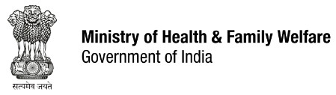



Reflections from the Government of India on the Partners’ Forum 2018
Vandana Gurnani, Joint Secretary (RCH),
Ministry of Health & Family Welfare,
Government of India
13 December 2018

Slide 2
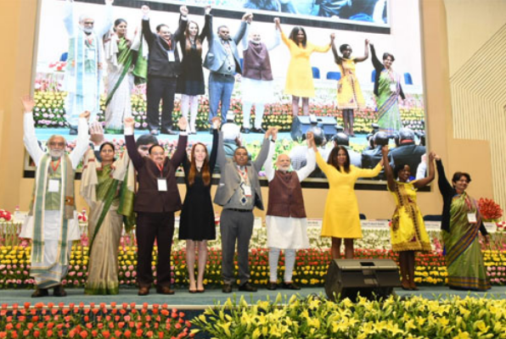
Partners’ Forum 2018

Slide 3
Commitment from the Government of India
Ensure that women, children and youth are at the centre of every policy, programme and initiative
Continue to work towards universal health coverage for all.
Increase India’s health spending to 2.5 percent of GDP by 2025 which implies an actual increase of 345 percent over the current share, in eight years.
Ayushman Bharat: Introduce 150, 000 Health & Wellness Centres by 2022, that will provide comprehensive primary care and health insurance cover to 500 million citizens under PM Jan Arogya Yojana

Slide 4
Commitment from the Government of India
Improve education, water, sanitation, rural development, health and nutrition in 117 aspirational districts.
Improve nutrition and compensate wage loss for more than 50 million pregnant women and lactating mothers before and after delivery as a part of the Pradhan Mantri Matru Vandana Yojana.
Ensure education and better quality of life for the girl child through ‘Beti Bacaho, Beti Padhao’ scheme.
Empower communities, improving health and education, ending poverty and boosting economic growth and ultimately, leaving no one behind.

Slide 5
India’s adaptation of the Global Strategy
India Strategy for Women’s, Children’s and Adolescents’ Health (I-WACH), 2018-30 seeks to ensure that every woman, child and adolescent realizes the attainment of the highest possible level of physical and mental health and well-being, has social and economic opportunities and can participate fully in shaping sustainable and prosperous societies.
Targets have been set in terms of ending preventable mortality (Survive) and enabling women, children and adolescents to enjoy good health (Thrive) while playing a full role in contributing to transformative change and sustainable development (Transform).
Key focus areas include leadership and governance; financing for health; quality, equity & dignity; multisectoral action; and community engagement.

Slide 6
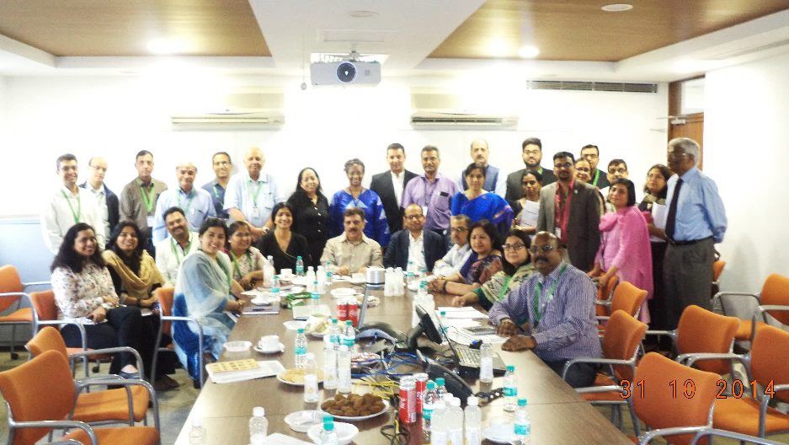
Developing country led Multi-stakeholders Platforms
The RMNCAH Coalition constituted by the Ministry of Health & Family Welfare emphasises upon alignment and partnership to further the country’s progress towards achieving its SDGs.
Facilitates multi-stakeholder engagement . A total of 134 representatives:
  UN agencies;
  Donors and Foundations;
  Non- Government Organization;
  Private Sector;
  Academic, Research and Training Institutes;
  Adolescents and Youth Organization and
  Government (including states and allied Ministries)
Four priority areas identified to galvanize efforts, augment momentum and mainstream innovative solutions and suggesting actionable recommendations:
  Early Childhood Development
  Adolescent health & Well-being
  Quality, Equity & Dignity in health services
  Urban health

Slide 7
Multistakeholder platforms: From rhetoric to action
The MoHFW, India holds annual good and replicable prcatices workshop to provide an opportunity to States and partners for cross-learning and evidence for action.
Various ministries and departments have entered formal partnerships for cross sectoral action:
  117 aspirational districts for transformation by 2022
  Intensified Mission Indradhanush- immunization
  Beti Bachao Beti Padhao (Save the Girl Child and educate her)
  Gram Swaraj Abhiyan (emowering the villages through seven essential services from seven departments)

Slide 8
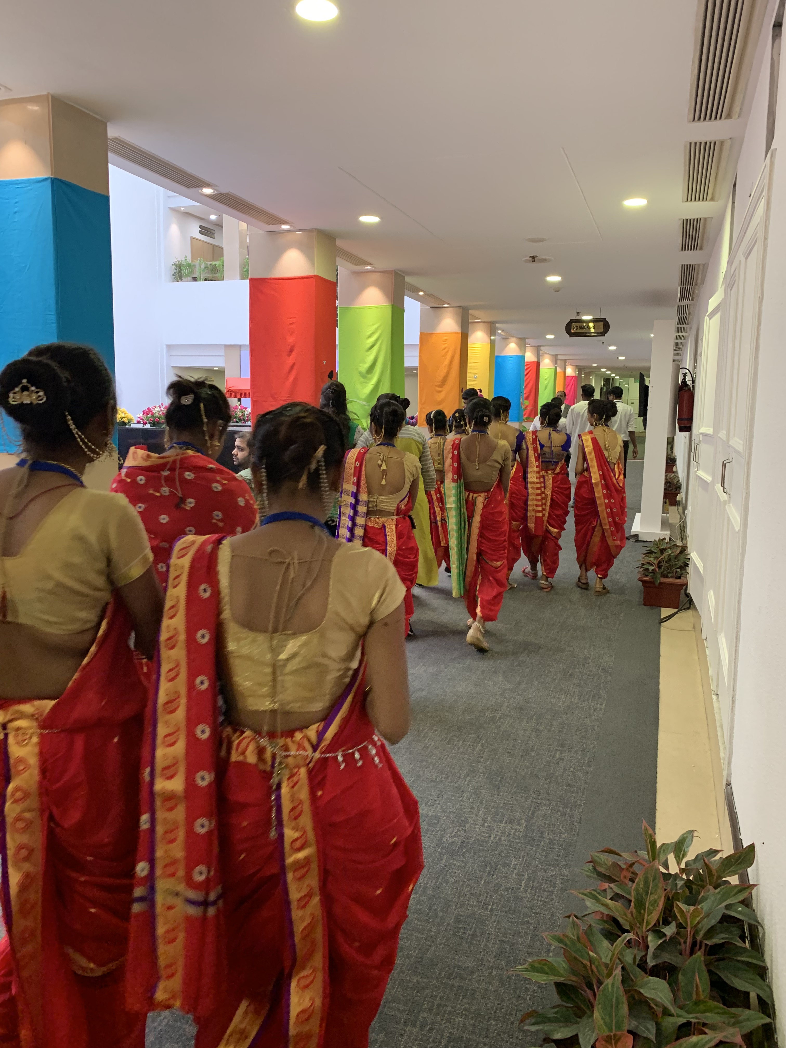
Thank You

